Slide 1
Image Compression with Neural Networks
Выполнили:
Мищенко В., Рассадин А., Русов Н.
2016 г.

Slide 2
Цели задачи
Сделать бенчмарк компрессии этого способа, png, webp, jpeg, jpeg2000.
Оценить численно и визуально качество, а так же время работы и размер сжатых изображений.
Возможно, ответить на вопрос о реальной применимости способа.

Slide 3
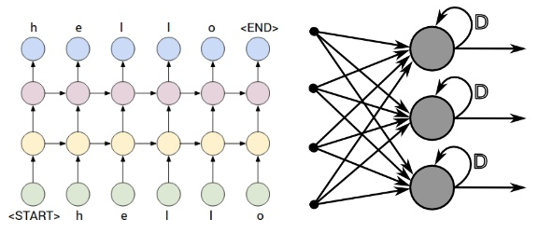
RNN
A recurrent neural network (RNN) is a class of artificial neural network where connections between units form a directed cycle.

Slide 4
Architectures
Fully recurrent network
Recursive neural networks
Hopfield network
Elman networks and Jordan networks
Echo state network
Neural history compressor
Long short term memory
Bi-directional RNN
Continuous-time RNN
Hierarchical RNN
Recurrent multilayer perceptron
Second order RNN
Multiple timescales recurrent neural network (MTRNN) model
Pollack's sequential cascaded networks
Neural Turing Machines
Neural network pushdown automata
Bidirectional associative memory

Slide 5
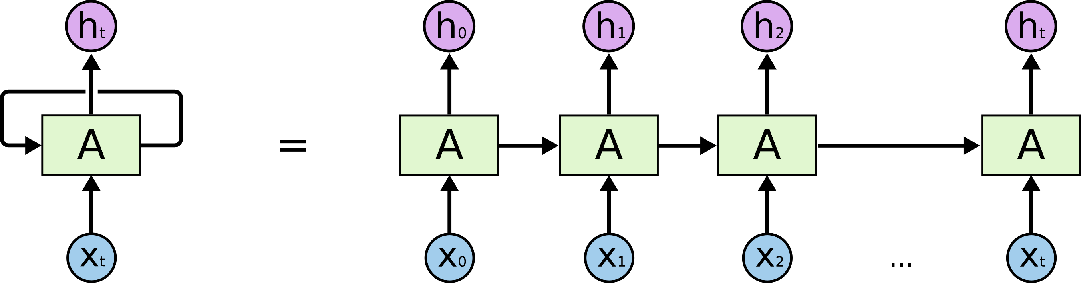
Long short-term memory
Long short-term memory (LSTM) is a recurrent neural network (RNN) architecture (an artificial neural network) proposed in 1997 by Sepp Hochreiter and Jürgen Schmidhuber.

Slide 6
Architecture
A LSTM network is an artificial neural network that contains LSTM blocks instead of, or in addition to, regular network units. A LSTM block may be described as a "smart" network unit that can remember a value for an arbitrary length of time. A LSTM block contains gates that determine when the input is significant enough to remember, when it should continue to remember or forget the value, and when it should output the value.

Slide 7
Training
To minimize LSTM's total error on a set of training sequences, iterative gradient descent such as backpropagation through time can be used to change each weight in proportion to its derivative with respect to the error.
A major problem with gradient descent for standard RNNs is that error gradients vanish exponentially quickly with the size of the time lag between important events

Slide 8
Gated recurrent unit
Gated recurrent units are a gating mechanism in recurrent neural networks, introduced in 2014.
Their performance on polyphonic music modeling and speech signal modeling was found to be similar to that of long short-term memory.
They have fewer parameters than LSTM, as they lack an output gate.

Slide 9
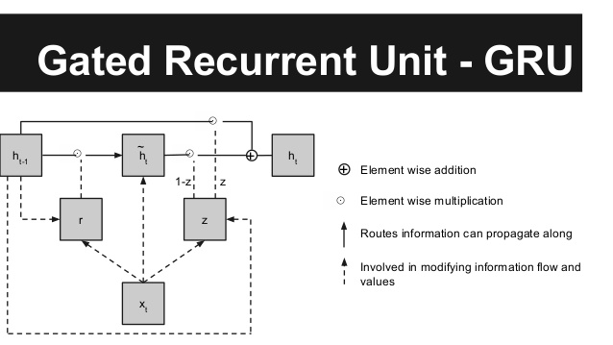

Slide 10
Residual GRU
Residual GRU combines existing GRUs with the residual connections to achieve significant image quality gains for a given compression rate.

Slide 11
The Article
Image Compression with Neural Networks (29.09.16)
Авторы – Google
They introduce an new architecture that called Residual Gated Recurrent Unit (Residual GRU)
Our system works by iteratively refining a reconstruction of the original image, with both the encoder and decoder using Residual GRU layers so that additional information can pass from one iteration to the next.
Each iteration adds more bits to the encoding, which allows for a higher quality reconstruction.

Slide 12
Algorithm
The initial residual, R[0], corresponds to the original image I: R[0] = I.
Set i=1 for to the first iteration.
Iteration[i] takes R[i-1] as input and runs the encoder and binarizer to compress the image into B[i].
Iteration[i] runs the decoder on B[i] to generate a reconstructed image P[i].
The residual for Iteration[i] is calculated: R[i] = I - P[i].
Set i=i+1 and go to Step 3 (up to the desired number of iterations).

Slide 13
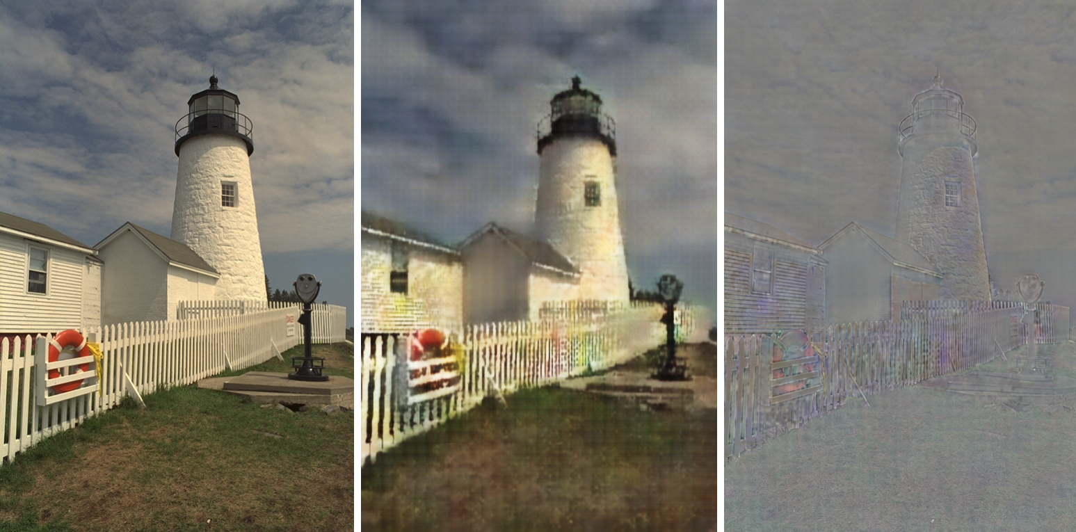
Example

Slide 14
Our results

Slide 15
Спасибо за внимание!

